Slide 1

Ensemble learning Stacking Linear Regression
Nestor V. Queipo
nqueipo@berkeley.edu https://github.com/nqueipo/The-RICE-visit
Houston, June 17th 2019
Notes:
Thank you for coming!; my name is Nestor. I would like to share the rationale for selecting this particular topic. 1. Why Ensemble learning? It is not only a fundamental topic in statistical learning but it is a methapor for what you are building here. The ensemble is expected to outperform any individual or average model (committee). 2. Why stacked linear regression? Law of parsimony (Occam’s razor) .. Not an irrefutable principle of logic but the solutions should be as simple and as interpretable as posible. 3. Also, I wanted to reflect on a canonical example of experiential learning in engineering that unveils an important but less explored area: design and manufacturing. FSAE: 2470 students from 120 university teams every year.

Slide 2
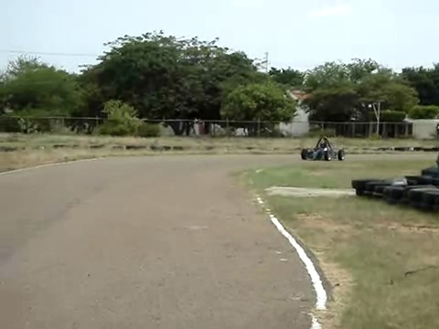
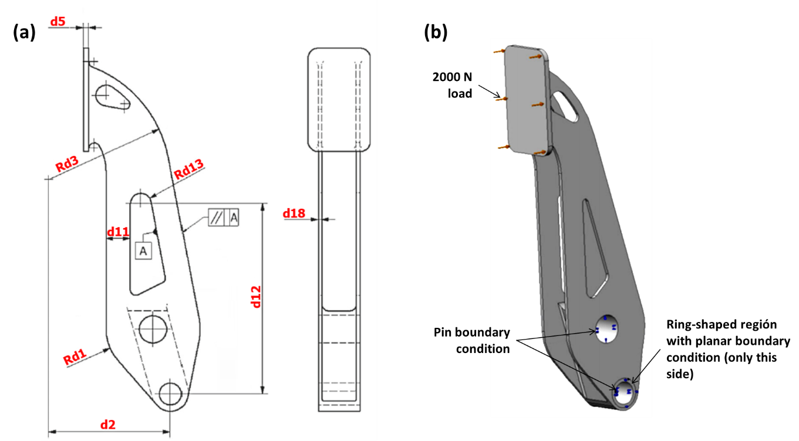
Outline
Being bullish about ensembles
Prerequisites and desired learning outcomes
Fundamental question: What is the relative contribution of the members of the ensemble?
EL-SLR basic steps
Brake pedal of a Formula …
Replication of results
Learning outcomes revisited
SAE vehicle (9D)
Notes:
It follows the classical structure of: motivation, prerequisites and desired learning outcomes, problema formulation, method, case study, how you can replicate the results discussed in this lectura and assessing the effectiveness of the learning experience.

Slide 3
1. Being bullish about ensembles
Ensemble learning is associated with state-of-the-art performance in machine learning
Omnipresent among top performers in data science competitions
Numerous applications in science and engineering, from heart disease (e.g., time to event), reservoir management, the weather, to rocket injector performance
Stacking linear regression delivers baseline performance for alternative ensemble approaches
Notes:
Kaggle and KDD cup competions. KDD is Knowledge Discovery and Data mining.

Slide 4
2. Prerequisites and desired learning outcomes
Prerequisites
Basic understanding of machine learning algorithms, i.e., linear regression, SVR, multilayer perceptron, Gaussian processes, and their hyper-parameters; holdout and cross-validation (DSCI 302, DSCI 303)
Python coding experience (COMP 140; CAAM 210)
Desired learning outcomes
L1 - Identify basic steps of the ensemble learning approach known as Stacking Linear Regression (SLR)
L2 - Implement SLR in Python using the packages MLXtend and scikit-learn (sklearn)
L3 - Recognize alternative ensemble learning approaches
Notes:
Mention that there will be an indicationof what learning

Slide 5
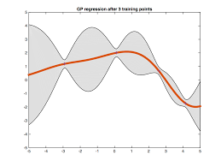
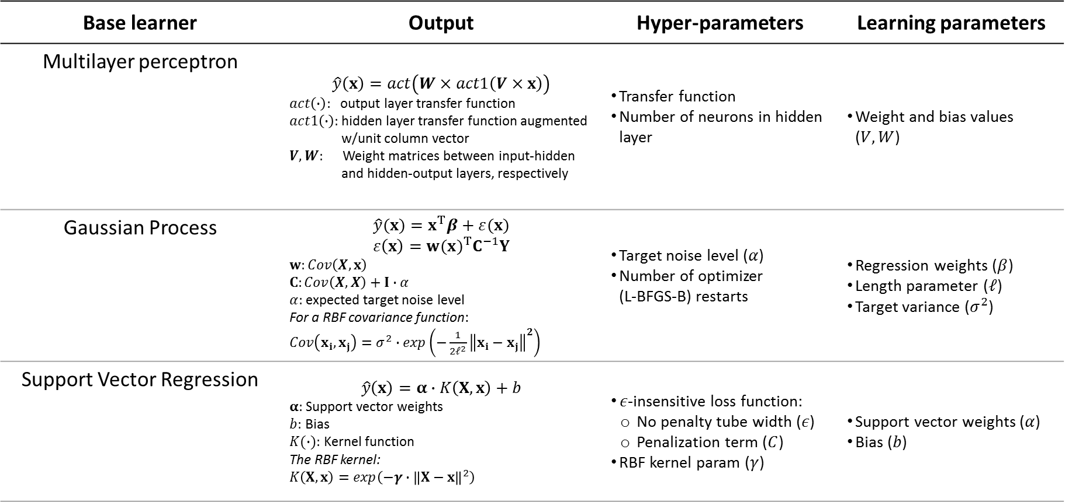
Base learners sample
Base learner | Output | Hyper-parameters | Learning parameters
Multilayer perceptron | $$\hat{y}\left(x\right)=act\left(W×act1\left(V×x\right)\right)$$ $act\left(∙\right):$ output layer transfer function $act1\left(∙\right):$hidden layer transfer function augmented w/unit column vector $V,W:$ Weight matrices between input-hidden and hidden-output layers, respectively | Transfer function Number of neurons in hidden layer | Weight and bias values ($V,W$)
Gaussian Process | $$\hat{y}(x)=x^{T}β+ε(x)$$ $$ε\left(x\right)={w(x)}^{T}C^{−1}Y$$ $w:Cov\left(X,x\right)$ $C:Cov\left(X,X\right)+I∙α$ $α:$ expected target noise level For a RBF covariance function: $Cov\left(x_{i},x_{j}\right)=σ^{2}∙exp\left({−\frac{1}{2ℓ^{2}}\left\|x_{i}−x_{j}\right\|}^{2}\right)$ | Target noise level ($α$) Number of optimizer (L-BFGS-B) restarts | Regression weights ($β$) Length parameter ($ℓ$) Target variance ($σ^{2}$)
Support Vector Regression | $$\hat{y}\left(x\right)=α∙K\left(X,x\right)+b$$ $α:$ Support vector weights $b:$ Bias $K(∙):$ Kernel function The RBF kernel: $K\left(X,x\right)=exp\left({−γ∙\left\|X−x\right\|}^{2}\right)$ | $ε$-insensitive loss function: No penalty tube width ($ε$) Penalization term ($C$) RBF kernel param ($γ$) | Support vector weights ($α$) Bias ($b$)
V
W
Multilayer perceptron
Gaussian process
Support Vector Regression
…
…
Σ
∊
V
W
σ²
σ²
…
C
…
Σ
0.4ℓ
0.4ℓ
∊
C
Notes:
Distinguish between learning and hyperparameters. Limited-memory BFGS (L-BFGS or LM-BFGS) is an optimization algorithm in the family of quasi-Newton methods that approximates the Broyden–Fletcher–Goldfarb–Shanno (BFGS) algorithm using a limited amount of computer memory. The L-BFGS-B algorithm extends L-BFGS to handle simple box constraints (aka bound constraints) on variables; that is, constraints of the form l_{i} ≤ x_{i} ≤ u_{i} where l_{i} and u_{i} are per-variable constant lower and upper bounds, respectively (for each x_{i}, either or both bounds may be omitted).^{[6][7]}

Slide 6
Ensembles taxonomy
L3
Diversity is key! .. ensemble generalization error -> bias, variance and covariance decomposition
Ensemble generation: homogenous vs heterogenous;, sequential vs parallel
Data manipulation: subsampling, random subspace, manipulating output targets
Ensemble integration: constant versus non-constant weighting functions
Heterogeneous ensembles can have homogenous ensembles as base learners
heterogenous
parallel
constant
weighting
functions
Stacking Linear Regression (SLR)
Notes:
These represent criteria by which alternative EL approaches can be identified; L3 identify alternative EL approaches

Slide 7

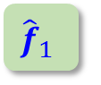

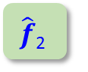
3. Fundamental question: assesing the weights The prediction view
New datum
$${\hat{f}}_{1}$$
$$\hat{f}\text{2}$$
...
$$\hat{f}\text{M}$$
Base learners
Trained
prediction
Stacking
P₁
P₂
...
P_{M}
Predictions
Linear regressor
Σ
Final prediction
P_{f}
Adapted from
Notes:
Let us assume the SLR model has already been identified. If we knew the weight the SLR prediction would be easy to compute. The issue is, we do not know the weights.

Slide 8
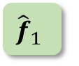

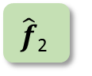
3. Fundamental question: assesing the weights The learning problem
Training data
New datum
training
$${\hat{f}}_{1}$$
$$\hat{f}\text{2}$$
...
$$\hat{f}\text{M}$$
Base learners
Trained
prediction
Stacking
P₁
P₂
...
P_{M}
Predictions
training
Linear regressor
w₁ w₂ ... w_{M}
Σ
Final prediction
P_{f}
Notes:
The learning view. That is, given a training set, what are the weights that will minimize the squared difference between predictions and the target values.

Slide 9


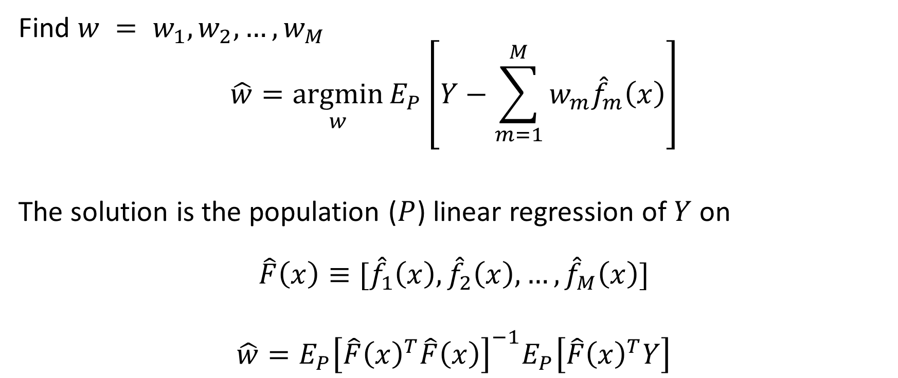
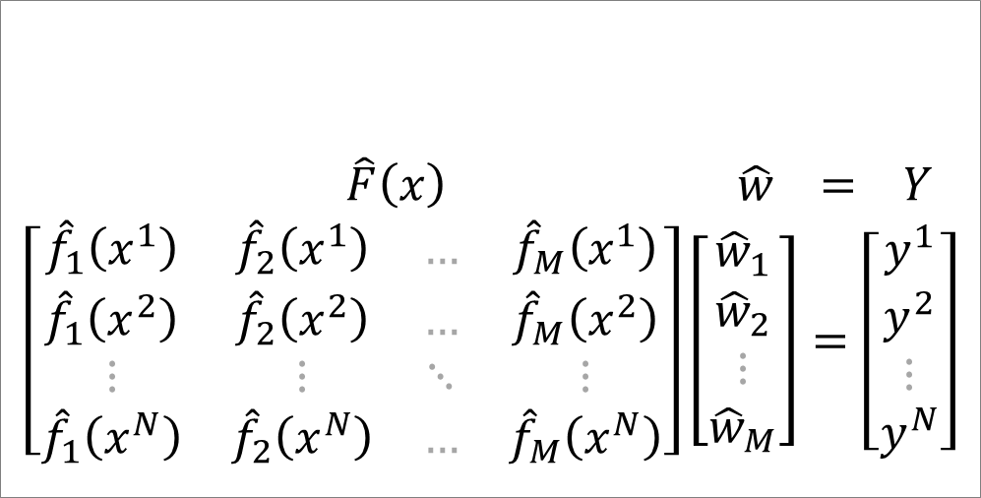
3. Fundamental question: assesing the weights The learning problem
Find $w = w_{1}, w_{2}, …, w_{M}$
$$\hat{w}=\underset{w}{argmin}{E_{Ρ}}\left[Y−\sum_{m=1}^{M}{w_{m}{\hat{f}}_{m}\left(x\right)}\right]$$
The solution is the population ($Ρ$) linear regression of $Y$ on
$$\hat{F}\left(x\right)≡[{\hat{f}}_{1}\left(x\right),{\hat{f}}_{2}\left(x\right),…,{\hat{f}}_{M}\left(x\right)]$$
$$\hat{w}=E_{Ρ}{\left[\hat{F}{\left(x\right)}^{T}\hat{F}\left(x\right)\right]}^{−1}E_{Ρ}\left[\hat{F}{\left(x\right)}^{T}Y\right]$$
$\hat{F}\left(x\right) \hat{w} = Y$
$$\left[\begin{matrix}{\hat{f}}_{1}\left(x^{1}\right) & {\hat{f}}_{2}\left(x^{1}\right) & … & {\hat{f}}_{M}\left(x^{1}\right) \\ {\hat{f}}_{1}\left(x^{2}\right) & {\hat{f}}_{2}\left(x^{2}\right) & … & {\hat{f}}_{M}\left(x^{2}\right) \\ ⋮ & ⋮ & ⋱ & ⋮ \\ {\hat{f}}_{1}\left(x^{N}\right) & {\hat{f}}_{2}\left(x^{N}\right) & … & {\hat{f}}_{M}\left(x^{N}\right)\end{matrix}\right]\left[\begin{matrix}{\hat{w}}_{1} \\ {\hat{w}}_{2} \\ ⋮ \\ {\hat{w}}_{M}\end{matrix}\right]=\left[\begin{matrix}y^{1} \\ y^{2} \\ ⋮ \\ y^{N}\end{matrix}\right]$$
Notes:
More specifically, we want to find the weights that minimize the difference between the target values and the weighted sum of the base learners predictions.

Slide 10

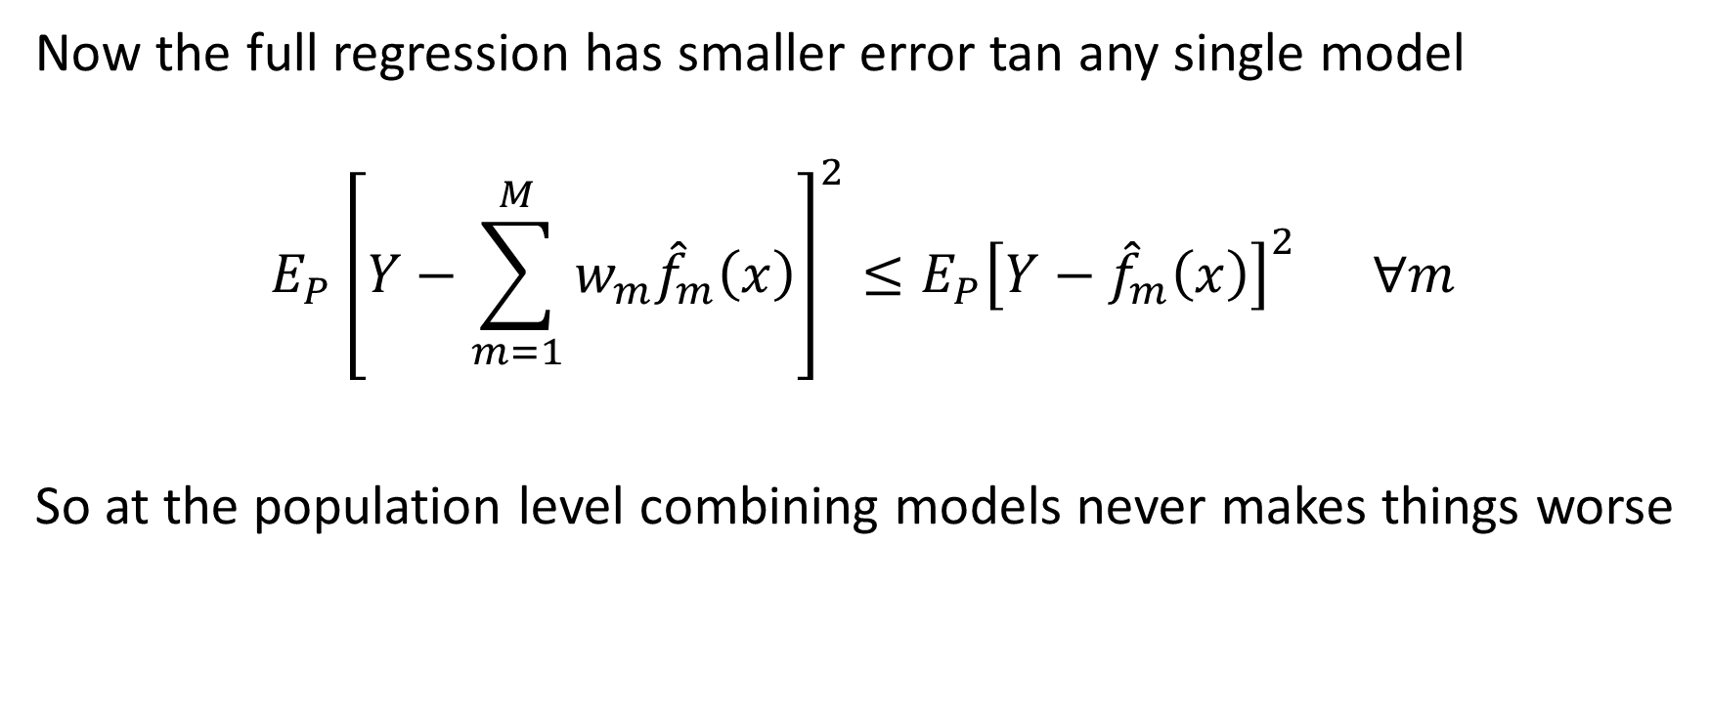
3. Fundamental question: assesing the weights The learning problem
Now the full regression has smaller error tan any single model
$$E_{Ρ}{\left[Y−\sum_{m=1}^{M}{w_{m}{\hat{f}}_{m}\left(x\right)}\right]}^{2}≤E_{Ρ}{\left[Y−{\hat{f}}_{m}\left(x\right)\right]}^{2} ∀m$$
So at the population level combining models never makes things worse

Slide 11
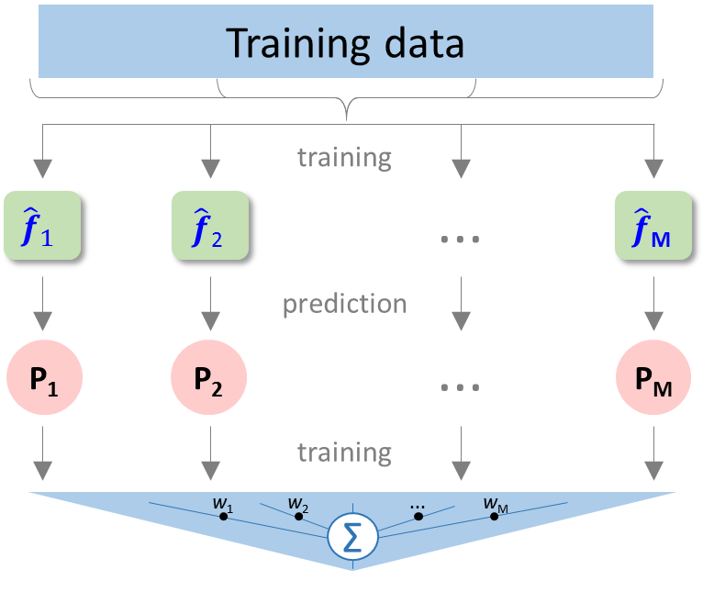
4. EL-SLR – Basic steps
L1
INPUT: Members of the ensemble with hyper-parameters grid
OUTPUT: SLR ensemble with relative contribution (weights) of the base-learners
main steps
5

Slide 12

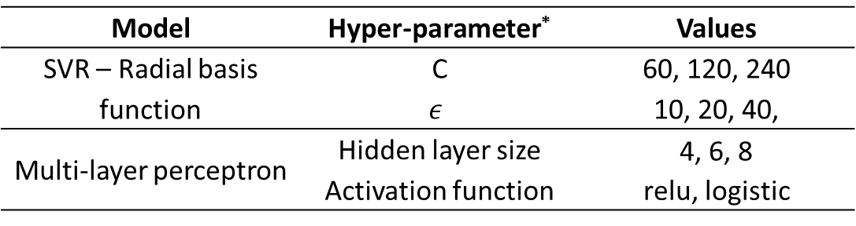
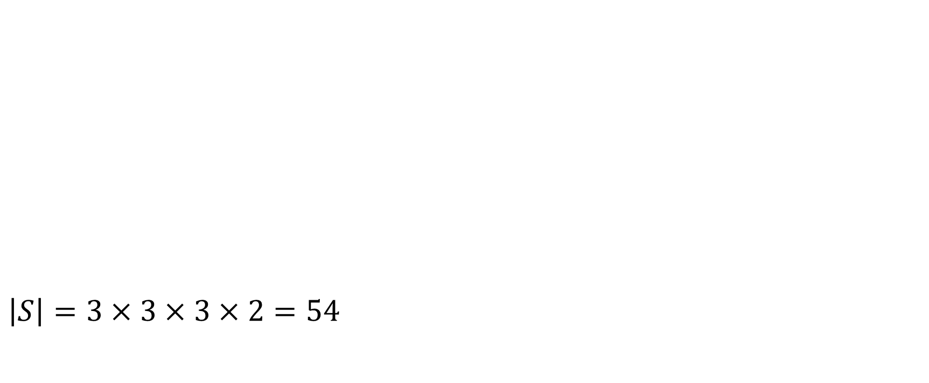
Step 1: Specify the set $S$ of possible hyper-parameters (grid) considering all the members of the ensemble
L1
1/5
$\left|S\right|=3×3×3×2=54$
Base learners hyper-parameters grid – FSAE brake pedal case study
Model | Hyper-parameter* | Values
SVR – Radial basis function | C | 60, 120, 240
 | $$ε$$ | 10, 20, 40,
Multi-layer perceptron | Hidden layer size | 4, 6, 8
 | Activation function | relu, logistic
* The C and $ε$ values under consideration are 0.5, 1.0 and 2.0 times the reference value calculated as proposed by Cherkassky and Ma (2004)
Notes:
This is the place for the hyper-parameters. The search space will be given by the size of the set S.

Slide 13
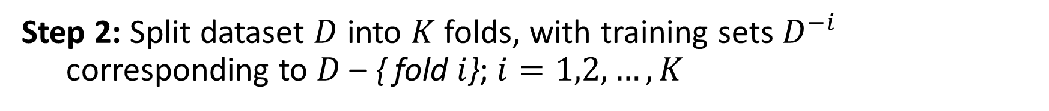
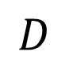
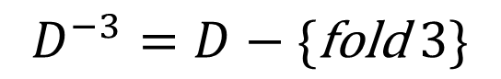
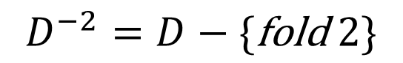
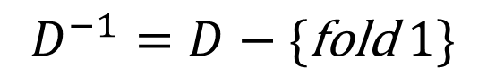

Step 2: Split dataset $D$ into $K$ folds, with training sets $D^{−i}$ corresponding to $D$ – { fold $i$}; $i=1,2,…,K$
Step 1: Specify the set $S$ of possible hyper-parameters (grid) considering all the members of the ensemble
L1
2/5
5-folds 1 2 3 4 5
$$D^{−2}=D−\{\text{fold} 2\}$$
$$D^{−3}=D−\{\text{fold} 3\}$$
$$D^{−1}=D−\{\text{fold} 1\}$$
$$D$$
Train
Test
Notes:
Rehacer figura.

Slide 14
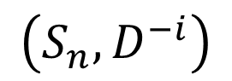
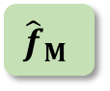
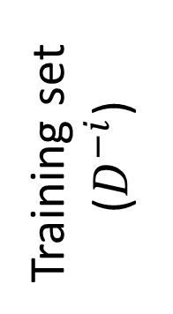
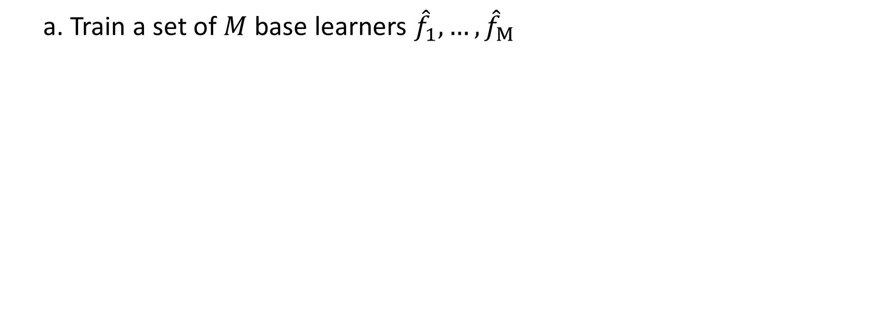
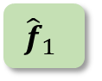

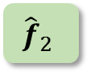
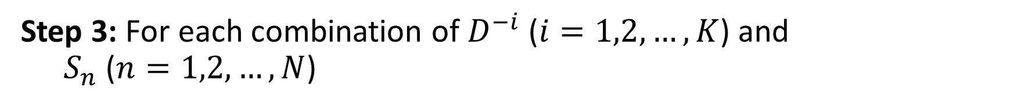
Step 3: For each combination of $D^{−i}$ ($i=1,2,…,K$) and $S_{n}$ ($n=1,2,…,N$)
Step 2: Split dataset $D$ into $K$ folds, with training sets $D^{−i}$ corresponding to $D$ – { fold $i$}; $i=1,2,…,K$
L1
3/5
a. Train a set of $M$ base learners ${\hat{f}}_{1},…,{\hat{f}}_{M}$
Base learners
$${\hat{f}}_{1}$$
Training set ($D^{−i}$)
$${\hat{f}}_{2}$$
...
$${\hat{f}}_{M}$$
Untrained
$$\left(S_{n}, D^{−i}\right)$$
Trained
Notes:
Upper case k

Slide 15

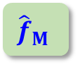
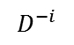
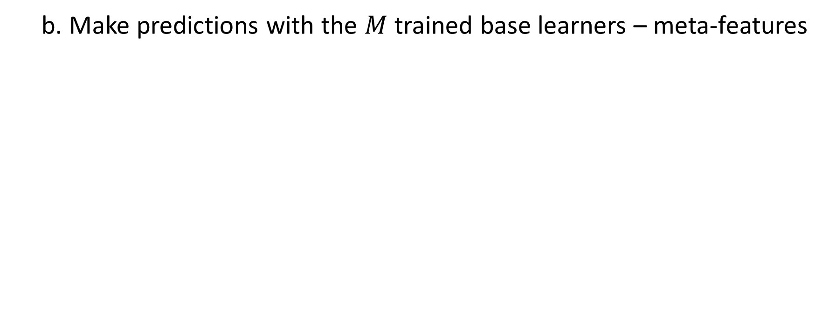
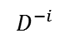
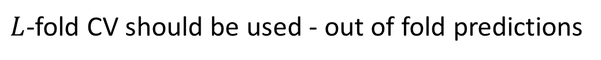
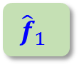
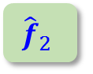
Step 3: For each combination of $D^{−i}$ ($i=1,2,…,K$) and $S_{n}$ ($n=1,2,…,N$)
Step 2: Split dataset $D$ into $K$ folds, with training sets $D^{−i}$ corresponding to $D$ – { fold $i$}; $i=1,2,…,K$
L1
b. Make predictions with the $M$ trained base learners – meta-features
Base learners
Predictions
$$D^{−i}$$
$${\hat{f}}_{1}$$
P₁
$$D^{−i}$$
Training set ($D^{−i}$)
$${\hat{f}}_{2}$$
P₂
...
...
$$D^{−i}$$
$${\hat{f}}_{M}$$
P_{M}
$$\left(S_{n}, D^{−i}\right)$$
$L$-fold CV should be used - out of fold predictions

Slide 16
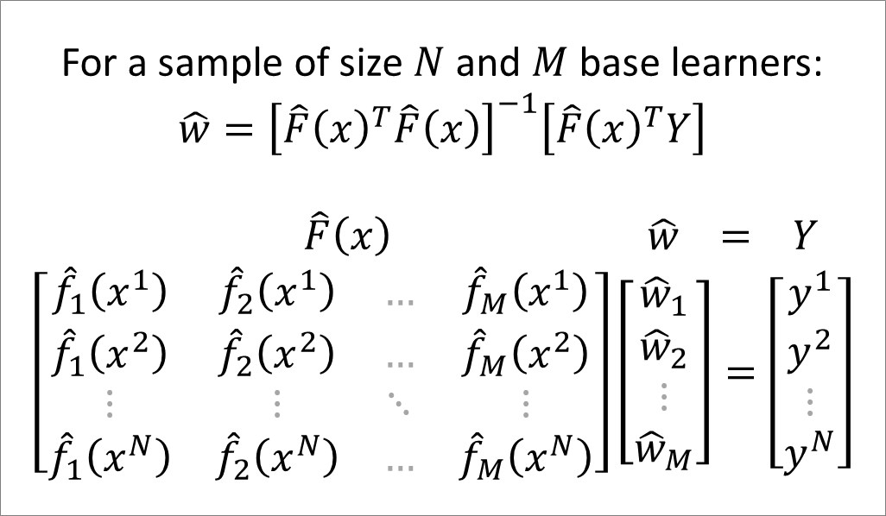
Step 3: For each combination of $D^{−i}$ ($i=1,2,…,K$) and $S_{n}$ ($n=1,2,…,N$)
Step 2: Split dataset $D$ into $K$ folds, with training sets $D^{−i}$ corresponding to $D$ – { fold $i$}; $i=1,2,…,K$
L1
c. Train (identify the weights) a stacking linear regressor using the meta features from step (b) and the corresponding target values
Base learners
Predictions
For a sample of size $N$ and $M$ base learners:
$$\hat{w}={\left[\hat{F}{\left(x\right)}^{T}\hat{F}\left(x\right)\right]}^{−1}\left[\hat{F}{\left(x\right)}^{T}Y\right]$$
$\hat{F}\left(x\right) \hat{w} = Y$
$$\left[\begin{matrix}{\hat{f}}_{1}\left(x^{1}\right) & {\hat{f}}_{2}\left(x^{1}\right) & … & {\hat{f}}_{M}\left(x^{1}\right) \\ {\hat{f}}_{1}\left(x^{2}\right) & {\hat{f}}_{2}\left(x^{2}\right) & … & {\hat{f}}_{M}\left(x^{2}\right) \\ ⋮ & ⋮ & ⋱ & ⋮ \\ {\hat{f}}_{1}\left(x^{N}\right) & {\hat{f}}_{2}\left(x^{N}\right) & … & {\hat{f}}_{M}\left(x^{N}\right)\end{matrix}\right]\left[\begin{matrix}{\hat{w}}_{1} \\ {\hat{w}}_{2} \\ ⋮ \\ {\hat{w}}_{M}\end{matrix}\right]=\left[\begin{matrix}y^{1} \\ y^{2} \\ ⋮ \\ y^{N}\end{matrix}\right]$$
Linear regressor
$$D^{−i}$$
$${\hat{f}}_{1}$$
P₁
$$D^{−i}$$
Training set ($D^{−i}$)
$${\hat{f}}_{2}$$
P₂
Σ
...
...
$$D^{−i}$$
$${\hat{f}}_{M}$$
P_{M}
Untrained
$$\left(S_{n}, D^{−i}\right)$$
Trained
Notes:
MLXtend allows to include the original input features (Xs) in the meta-regressor REF: http://rasbt.github.io/mlxtend/api_subpackages/mlxtend.regressor/#stackingcvregressor
use_features_in_secondary : bool (default: False)
If True, the meta-regressor will be trained both on the predictions of the original regressors and the original dataset. If False, the meta-regressor will be trained only on the predictions of the original regressors.

Slide 17
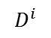
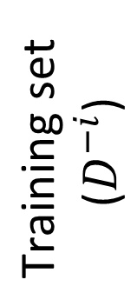

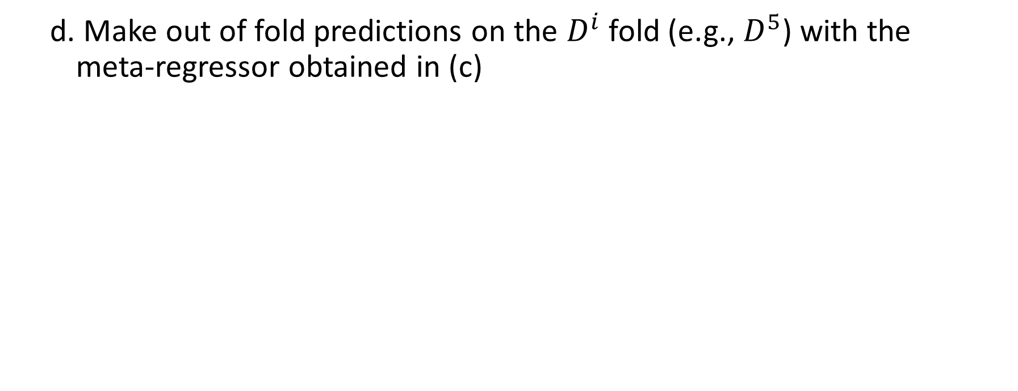
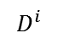
Step 3: For each combination of $D^{−i}$ ($i=1,2,…,K$) and $S_{n}$ ($n=1,2,…,N$)
Step 2: Split dataset $D$ into $K$ folds, with training sets $D^{−i}$ corresponding to $D$ – { fold $i$}; $i=1,2,…,K$
L1
d. Make out of fold predictions on the $D^{i}$ fold (e.g., $D^{5}$) with the meta-regressor obtained in (c)
Base learners
Predictions
Linear regressor
$$D^{i}$$
$$D^{−i}$$
$${\hat{f}}_{1}$$
P₁
$$D^{i}$$
$$D^{−i}$$
$$\text{Training} \text{set} \\ \text{(}D^{−i}\text{)}$$
$${\hat{f}}_{2}$$
P₂
$$D^{i}$$
Fold $i$ ($D^{i}$)
P_{f}
Out of fold prediction
Σ
...
...
$$D^{i}$$
$$D^{−i}$$
$${\hat{f}}_{M}$$
P_{M}
$$\left(S_{n}, D^{−i}\right)$$
Trained

Slide 18
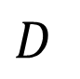
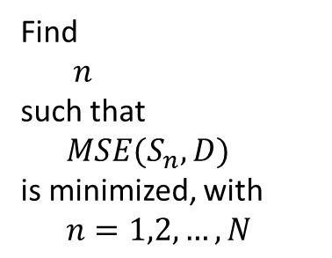
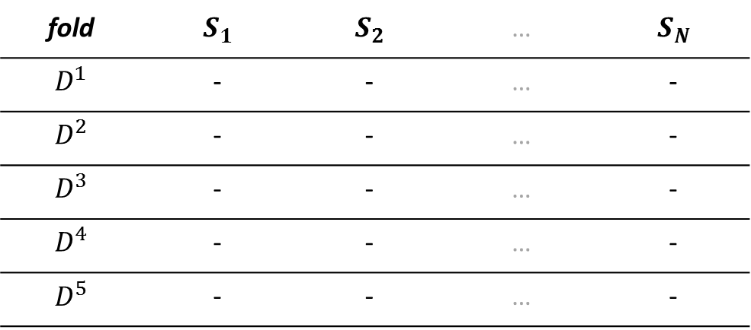
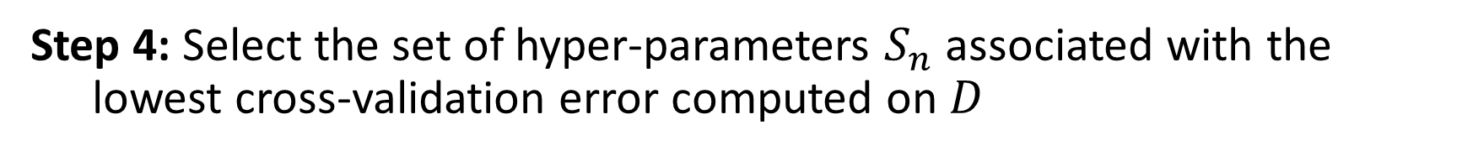
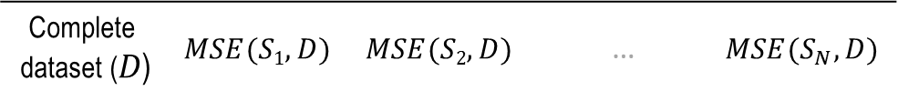
Step 4: Select the set of hyper-parameters $S_{n}$ associated with the lowest cross-validation error computed on $D$
Step 3: For each combination of $D^{−i}$ ($i=1,2,…,K$) and $S_{n}$ ($n=1,2,…,N$)
L1
4/5
5-folds 1 2 3 4 5
fold | $$S_{1}$$ | $$S_{2}$$ | … | $$S_{N}$$
$$D^{1}$$ | - | - | … | -
$$D^{2}$$ | - | - | … | -
$$D^{3}$$ | - | - | … | -
$$D^{4}$$ | - | - | … | -
$$D^{5}$$ | - | - | … | -
Find $n$
such that $MSE(S_{n}, D)$
is minimized, with $n=1,2,…,N$
$$D$$
$$\text{Complete} \text{dataset}\text{ (}D\text{)}$$ | $$MSE(S1,D)$$ | $$MSE(S2,D)$$ | … | $$MSE(S_{N},D)$$
Train
Test

Slide 19
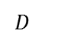
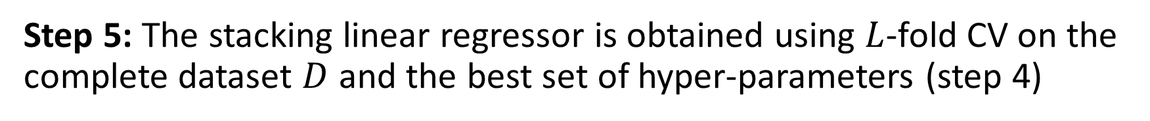
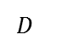
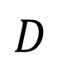

Step 5: The stacking linear regressor is obtained using $L$-fold CV on the complete dataset $D$ and the best set of hyper-parameters (step 4)
Step 4: Select the set of hyper-parameters $S_{n}$ associated with the lowest cross-validation error computed on $D$
L1
5/5
Base learners
Predictions
Linear regressor
$$D^{}$$
$${\hat{f}}_{1}$$
P₁
$$D^{}$$
$${\hat{f}}_{2}$$
P₂
$$D$$
Σ
...
...
$$D^{}$$
$${\hat{f}}_{M}$$
P_{M}
Trained
19
Notes:
Include a note that says, realistically, we do cross-validation on D-i

Slide 20
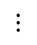
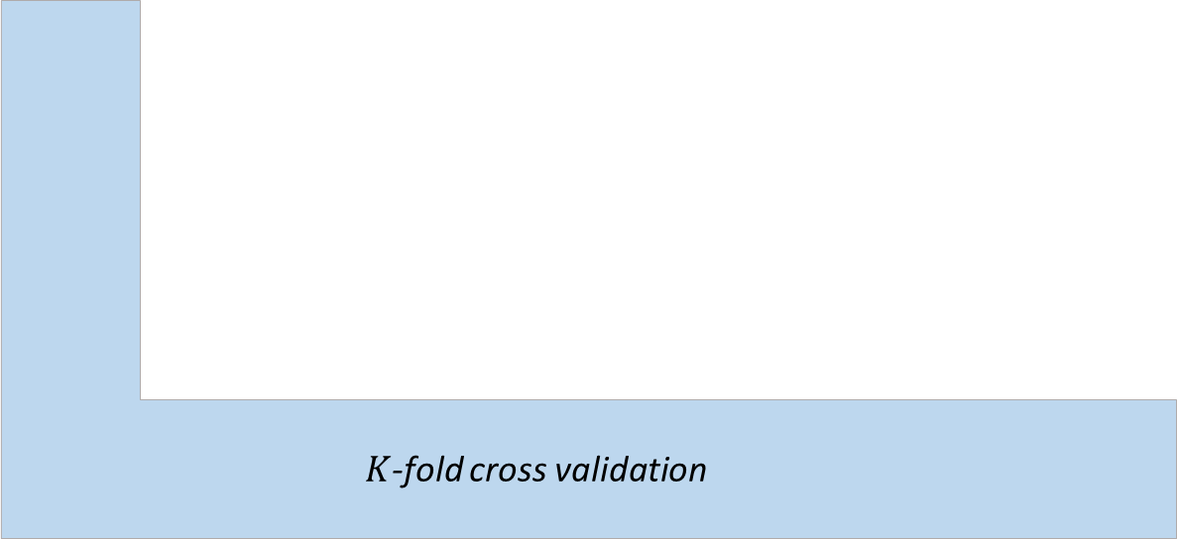

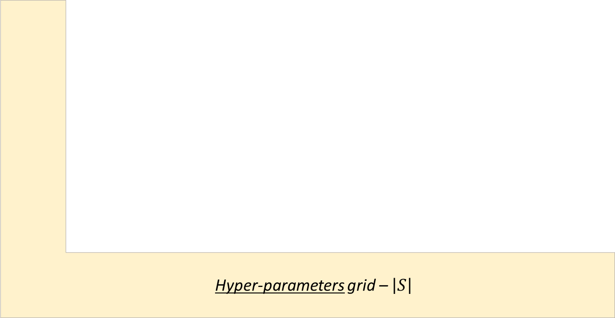



The five step summary
Q1
Step 2
Step 3.d
Step 3.b
Step 3.a
Step 3.c
Step 4
Step 5
$L$-fold cross validation
Hyper-parameters grid – $\left|S\right|$
$K$-fold cross validation
$${\hat{f}}_{1}$$
Meta-regressor
Best set of hyper-parameters
Refit
$${\hat{f}}_{2}$$
$$⋮$$
$${\hat{f}}_{M}$$
Step 1

Slide 21


Implementation
L2
from mlxtend.regressor \ import StackingRegressor, StackingCVRegressor
Reference: Raschka S (2018) MLxtend: Providing machine learning and data science utilities and extensions to Python’s scientific computing stack J Open Source Software 3(24) doi: 10.21105/joss.00638
Available at: http://rasbt.github.io/mlxtend/
from sklearn.model_selection import GridSearchCV
Reference: Pedregosa et al. (2018) Scikit-learn: Machine Learning in Python. J Machine Learning Research 12:2825-2830
Available at: https://scikit-learn.org/stable/index.html
Notes:
Confirmar que el enlace a scikit funciona

Slide 22
Implementation
L2
# Ensemble definition
slreg = StackingCVRegressor(regressors= \
[ SVR(kernel='rbf'), \
Pipeline([('preprocessing',PolynomialFeatures(1)), ('regressor',LinearRegression())]), \
MLPRegressor(solver='lbfgs'), \
GaussianProcessRegressor(alpha=0.5, n_restarts_optimizer=4, normalize_y=False, \
kernel=Co(40.0, (1e-3, 1e2))*RBF(length_scale=0.45, length_scale_bounds=(1e-2, 1e1))) \
], meta_regressor=LinearRegression(fit_intercept=False), cv=5)
# Hyper-parameters setting (step 1)
hparams = {'svr__C': [55.0, 110.0, 220.0], \
'svr__epsilon': [0.1, 1.0, 10.0], \
'mlpregressor__hidden_layer_sizes': [4, 6, 8], \
'mlpregressor__activation': ['relu','logistic']}
Size of the L-fold (inner) CV
Notes:
The results are with StackingCVRegressor and the Implementation should reflect that – Update accordingly

Slide 23
Implementation
L2
# Model selection (steps 2-5)
grid = GridSearchCV(estimator=slreg, param_grid=hparams, cv=5, refit=True, \
scoring='neg_mean_squared_error')
grid.fit(Xtrain, ytrain)
best_hparams = grid.best_params_
slr_model = grid.best_estimator_
# Test error
test_error = mean_squared_error(slr_model.predict(Xtest), ytest)
Size of the K-fold (outer) CV

Slide 24

5. Case study – FSAE brake pedal
INPUT: 8 geometric parameters (in red) and the Young modulus (E) of the material
OUTPUT: Maximum von Mises stress
Notes:
What is a limiting value for Aluminium? What material was used? .. Questions of interest?
1. How well does SLR performs when compared to individual surrogates? We know theoretically it should never do worse than the individual surrogates (population level) but how well it does when evaluated on a simple? 2. How well it does when compared to a committee?

Slide 25
5. Case study – FSAE brake pedal
Training and testing sets are complementary of size 90 and 1230
150 trials
Feature probability distributions
Feature | Distribution | Parameters
 |  | Mean | Std.Dev.
d1 | Normal | 30.0 | 2.021
d2 |  | 75.0 | 3.350
d3 |  | 78.5 | 5.371
d5 |  | 3.0 | 0.751
d11 |  | 13.0 | 3.177
d12 |  | 97.5 | 10.570
d13 |  | 6.5 | 1.040
d18 |  | 4.0 | 1.348
E | LogNormal | 11.059 | 0.071
Maximum von Mises stress distribution
Min | Median | Mean | Std.Dev. | Max
0 | 85.065 | 97.464 | 43.870 | 294.310
Notes:
Characterize each input .. E es lognormal .. What did we do? We should have probably normalize according to a particular distribution .. Directly from the data set

Slide 26




Prediction view – Seed: 1024
Base learners
Linear regressor
R²
Coefficients
R²
$$SVR−RBF$$
0.966
0.1850
0.8990
$$LR$$
0.809
0.4744
Training set
Σ
$$MLP$$
0.910
0.4563
$$GP$$
0.999
-0.1441
Notes:
Shouldn’t it be testing?

Slide 27




Prediction view – Seed: 1024
Base learners
Linear regressor
MAE
MSE
Coefficients
MAE
MSE
$$SVR−RBF$$
11.1
439.6
0.1850
8.6
336.1
$$LR$$
14.8
480.8
0.4744
Testing set
Σ
$$MLP$$
14.4
547.8
0.4563
$$GP$$
15.0
838.1
-0.1441
MAE: Median absolute error
Notes:
Shouldn’t it be testing?

Slide 28

Performance – Training data
Stacking Linear Regressor
Base learners performance
Mean squared error
SVR-RBF LR MLP GP
Notes:
Integrate Training and Testing – (1) Base learners performance on training on the left and testing on the right (with weight distribution on the bottom; (2) Committee prediction and stacking
linear regressor; (3) Tables with median comparison: then the distributions of MSE with Table with median comparison for 180 points

Slide 29

Performance – Training data
Stacking Linear Regressor
Base learners performance
Median absolute error
SVR-RBF LR MLP GP
Notes:
Integrate Training and Testing – (1) Base learners performance on training on the left and testing on the right (with weight distribution on the bottom; (2) Committee prediction and stacking
linear regressor; (3) Tables with median comparison: then the distributions of MSE with Table with median comparison for 180 points

Slide 30
Performance – Training data
SLR meta-regressor coefficients
Weights
SVR-RBF LR MLP GP
Notes:
Integrate Training and Testing – (1) Base learners performance on training on the left and testing on the right (with weight distribution on the bottom; (2) Committee prediction and stacking
linear regressor; (3) Tables with median comparison: then the distributions of MSE with Table with median comparison for 180 points

Slide 31

Performance - Testing data
Stacking Linear Regressor
Base learners performance
Committee
Mean squared error
SVR-RBF LR MLP GP
Notes:
What are characteristic values of the Maximum von Mises Stress; are the errors reasonable?

Slide 32


Winner
Ensemble | Median (MSE)
SLR | 369.1
Committee | 436.1
18%
90 samples
150 trials
180 samples
Ensemble | Median (MSE)
SLR | 285.0
Committee | 340.2
16%
Winner: lowest MSE
Notes:
What are characteristic values of the Maximum von Mises Stress; are the errors reasonable?

Slide 33
Summary
Stacking linear regression is one of the simplest yet effective EL approaches; can be used to benchmark more sophisticated schemes
SLR can be implemented using nested cross-validation and the regression normal equation; the StackingCVRegressor class is available in the MLxtend package
A natural extension: fit the predictions to non-linear regressors (non-constant weights)
Alternative EL approaches consider homogenous base learners, sequential generation of the members of the ensemble, and data manipulation, such as random subspace and subsampling

Slide 34
6. Revisiting desired learning outcomes

Slide 35
7.1 Q&A sample question
Q1
I. In a StackingCVRegressor with M base learners and K (external) and L (internal) - fold cross-validation, how many base learners and meta linear regressors are trained (ignore refit – step 5)?
(K x L x M), (K x L)
(|S| x K x M), (|S| x K)
(|S| x K x L x M), (|S| x K)
(|S| x M), (|S|)
(K x M), (|S| x K x L)
|S|: Size of hyper-parameters set
Notes:
Animate the true answer
True Answer:
Number of base learners trained: |S| x K x L x M
Number of meta-regressors trained: |S| x K

Slide 36

7.2 Sample assigment
Implement a stacking cross-validation regressor for the FSAE brake pedal case study and evaluate:
A. Bias and variance for each member of the ensemble, namely,
$\overline{bias}=\frac{1}{M}{\sum_{i}{\left(E\left\{f_{i}\right\}−y\right)}}^{2}$ $\overline{var}=\frac{1}{M}\sum_{i}{E}\{{\left(f_{i}−E\left\{f_{i}\right\}\right)}^{2}\}$
B. Covariance between the members of the ensemble, i.e.,
$$\left.\overline{covar}=\frac{1}{M\left(M−1\right)}\sum_{i}{\left.\sum_{j≠i}{E}\right\{}(f_{i}−E\{f_{i}\})(f_{j}−E\{f_{j}\})\right\}$$
Assess how much diversity there is among the base learners
C. The impact of using a non-linear meta-regressor of your choice
Notes:
Rewrite the equation as cov fi,fj (hat) =

Slide 37



7. Replication of results
theRICEvisit
Lecture
Notebooks and data
Colaboratory (cloud)
Jupyter (local)
Refs
Jupyter notebooks and Colaboratory
Software dependencies
Classes of particular interest
Explicit declaration of random seeds
GitHub & DOI (Zenodo)
Data and code (Jupyter notebook) needed to replicate the results for the FSAE brake pedal case study can be found at https://github.com/nqueipo/RiceVisitJun2019
References: Haftka R, Zhou M, and Queipo N (2019) Replication of results (in press), Structural and Multidisciplinary Journal Editorial, Springer, ISSN1615-147X

Slide 38

References
Section 8.8 Model Averaging and Stacking,
pag. 288-290
Notes:
Incorporate this reference: Raschka S (2018) “MLxtend: Providing machine learning and data science utilities and extensions to Python’s scientific computing stack” J Open Source Software. 3(24). doi: 10.21105/joss.00638
Available at: http://rasbt.github.io/mlxtend/; showing in the left how the place to download the software looks like

Slide 39

References
L Breiman. Stacked regressions. Machine Learning, 24, 49-64 (1996)
Notes:
Incorporate this reference: Raschka S (2018) “MLxtend: Providing machine learning and data science utilities and extensions to Python’s scientific computing stack” J Open Source Software. 3(24). doi: 10.21105/joss.00638
Available at: http://rasbt.github.io/mlxtend/; showing in the left how the place to download the software looks like

Slide 40
References
T Goel, RT Haftka, W Shyy, NV Queipo. Ensemble of surrogates. Structural and Multidisciplinary Optimization 33 (3) 199-216, 2007
E Sanchez, S Pintos, NV Queipo. Toward an optimal ensemble of kernel-based approximations with engineering applications. Structural and Multidisciplinary Optimization 36 (3) 247-261, 2008
NV Queipo, E Nava. A gradient boosting approach with diversity promoting measures for the ensemble of surrogates in engineering. Structural and Multidisciplinary Optimization, 2019 (Accepted)
J Romero, N Queipo. Reliability-based and deterministic design optimization of a FSAE brake pedal: a risk allocation analysis. Structural and Multidisciplinary Optimization 56 (3), 681-695, 2017
Notes:
Incorporate this reference: Raschka S (2018) “MLxtend: Providing machine learning and data science utilities and extensions to Python’s scientific computing stack” J Open Source Software. 3(24). doi: 10.21105/joss.00638
Available at: http://rasbt.github.io/mlxtend/; showing in the left how the place to download the software looks like

Slide 41
Weights for seed 1003: [ 0.67013556 0.34321198 0.08141871 -0.08180501]
Method R2 MSEtr MSEte MAEtr MAEte
0 SVR-RBF 0.952130 106.212639 490.119275 0.100144 9.797582
1 LR 0.733775 590.699001 438.608389 12.724948 12.111712
2 MLP 0.932720 149.279723 568.774574 5.495529 12.996118
3 GP 0.999921 0.175994 957.081587 0.177618 15.211539
4 SLR 0.865355 298.749935 376.541265 4.867059 9.321848
5 SUR-avg 0.952136 106.199730 446.763492 3.046561 9.176937
Weights for seed 1019: [ 0.14207267 0.57311272 0.36353741 -0.09700699]
Method R2 MSEtr MSEte MAEtr MAEte
0 SVR-RBF 0.947043 82.913308 612.858370 0.100178 10.590346
1 LR 0.838081 253.510892 456.261156 8.922276 12.705566
2 MLP 0.966836 51.923504 384.283009 3.976576 11.177877
3 GP 0.999872 0.201028 1065.582851 0.241636 15.766032
4 SLR 0.881307 185.832427 373.244955 6.735490 9.792148
5 SUR-avg 0.969278 48.099874 441.591453 2.477796 9.291427
Weights for seed 372: [ 0.20093722 0.46988874 0.43033221 -0.11451806]
Method R2 MSEtr MSEte MAEtr MAEte
0 SVR-RBF 0.998552 2.721334 549.764006 1.000162 12.102404
1 LR 0.791315 392.162243 460.111570 6.985825 13.855128
2 MLP 0.950050 93.866558 94888.726769 5.245317 10.898522
3 GP 0.999896 0.196023 865.464801 0.230494 13.552871
4 SLR 0.917643 154.765642 414.018891 3.337916 9.111734
5 SUR-avg 0.974777 47.398925 6157.596935 3.087857 9.918016
Weights for seed 1024: [ 0.18504583 0.47440752 0.45629651 -0.14411745]
Method R2 MSEtr MSEte MAEtr MAEte
0 SVR-RBF 0.966349 94.157408 439.637485 0.100043 11.086281
1 LR 0.808748 535.139364 480.768570 15.095004 14.764846
2 MLP 0.910136 251.446679 547.774305 7.430028 14.400469
3 GP 0.999854 0.407729 838.145660 0.240972 14.955008
4 SLR 0.899066 282.420344 336.061694 9.053749 8.596614
5 SUR-avg 0.960261 111.193343 353.678676 4.943307 8.207659
Weights for seed 7756: [0.27891483 0.47764049 0.2357791 0.01394015]
Method R2 MSEtr MSEte MAEtr MAEte
0 SVR-RBF 0.966831 57.030844 536.898805 0.100016 10.316136
1 LR 0.795069 352.360452 447.154462 12.909622 11.584299
2 MLP 0.993196 11.698425 537.492971 0.185911 12.915465
3 GP 0.999874 0.216460 1008.782801 0.233664 14.938486
4 SLR 0.929423 121.350839 372.676787 6.148824 8.837185
5 SUR-avg 0.977802 38.166926 447.419290 3.133420 8.859647

